Slide 1
ADA 101
Tina Vires, M.Ed.
OARS Director
(Adapted in part from an esteemed colleague, Judy Bagley, Director of the Student Office of Accessibility Resources, at Furman University)

Slide 2
Disability: Legal Definition
The ADA defines disability as:
a physical or mental impairment that substantially limits one or more major life activities,
a record of such an impairment, or
being regarded as having such an impairment.
The ADAAA (2008) broadened this definition.
Major life activities include walking, seeing, hearing, speaking, breathing, learning, working, caring for oneself, writing, and performing manual tasks.
Notes:
TV

Slide 3
Presumptive Disabilities
Deafness
Blindness/Low Vision
Speech
Intellectual
Autism
Partial/Complete Missing Limbs
Mobility
Epilepsy
Cancer
Diabetes
Cerebral Palsy
Schizophrenia
Major Depressive Disorder
Bipolar Disorder
PTSD
TBI
Multiple Sclerosis
Muscular Dystrophy
OCD
Etc.
Notes:
Presumptive disability refers to medical conditions that are obviously or easily presumed to be a total disability

Slide 4
Why Talk About Disability?
Colleges and Universities are striving to be more inclusive. When we talk about inclusivity, it's absolutely crucial to include disability alongside gender, race, sexuality, religion, socioeconomic background, and so forth. Disability is not an "accident," or "difficulty," or even a "special need." It is an identity.
We have a growing number of students with disabilities, with increasingly complex needs.
We have a wide range of disabilities on campus, and most of the disabilities are invisible.
Notes:
TV

Slide 5
The ADA is Civil Rights Legislation
Remove barriers
Provide equity of access
Ensure equal opportunity for people with disabilities in society
Notes:
TV

Slide 6
Why should we invest in access and inclusion?
"I've sometimes heard people say, 'Oh, well there are no disabled people at my club or at my store.' If there are no disabled people in your community, that's a sign that there are barriers. Disability is something that touches all of our lives at some point, whether it's family members or friends, or coworkers. Our bodies are always changing and we deserve dignity and access at every stage in our lives. So it's not just for an imaginary other. It could be for your future selves. So it benefits all of us to invest in accessibility.“ – Haben Girma
Notes:
Haben is the first deaf-blind person to graduate from Harvard Law.

Slide 7
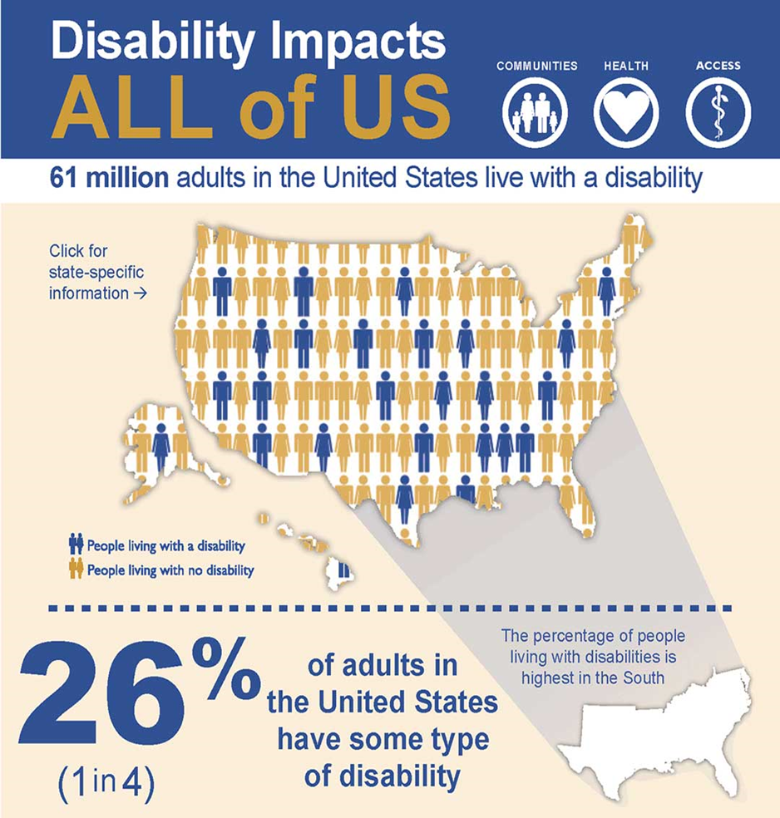
Statistics
1 in 4 individuals in the US identifies as having a disability (26% or 61 million)
19% of undergraduate college students identify as having a disability
>1,568 current UNCG students identify as having a disability
https://www.cdc.gov/ncbddd/disabilityandhealth/infographic-disability-impacts-all.html
Notes:
TV

Slide 8
A Brief History of Disability Public opinion, treatment, and rights
As “invisibles,” our history is hidden from us, our heroes buried in the pages, unnamed, unrecognized. Disability culture is about naming, about recognizing.
--Cheryl Marie Wade, “Disability Culture Rap”
Notes:
TV

Slide 9
It wasn’t until the mid-1940s that society started to recognize that people with disabilities had value and deserved equal treatment.
Notes:
A rare photo of FDR in his wheelchair (1941). FDR was the only man with a significant visible physical disability to serve as a US president. He was able to hide his disability from the public, . He believed secrecy was a necessity fearing that wide spread knowledge of his disability would detract from his authority.

Slide 10
Disability History
1867-1974: The Ugly Laws
1907: Indiana’s state legislature passed an ordinance for involuntary sterilization; other states followed suit
1932: Social Security Act of 1935 was passed
1938: Fair Labor Standards Act
1943: Disabled Veterans Act
1964: Civil Rights Act
1968: Architectural Barriers Act
Notes:
Think about the history lessons you’ve learned. It is most likely disability didn’t come up much. Did you know that abolitionist and underground railroad conductor was disabled. A slave owner threw a weight at her that caused head trauma, leading to a form of epilepsy. Artist Frida Kahlo acquired physical disabilities from both polio and a bus accident. We can trace records of disability all the way back to ancient Sparta, where disabled infants were left to die because they were deemed worthless if they couldn’t be warriors. We also have PT Barnum's freak shows which were started in the 1800s as a way to make money by putting people with physical differences on display for the public to gawk.

Slide 11
History II
1970: Urban Mass Transit Act
1970: Judy Heumann wins lawsuit against NYC public schools for employment discrimination
1973: Rehabilitation Act of 1973
1974: Repeal of Ugly Laws
1975: Education for All Handicapped Children Act (name later changed to IDEA in 1997)
1977: Section 504 of the Rehabilitation Act implementation begins
Notes:
1970: Urban Mass Transit Act; required all new mass transit vehicles to have a wheelchair lift
1970: Judy Heumann wins lawsuit against NYC public schools for employment discrimination. Contracted polio as a child and used a wheelchair and was denied her teacher certification b/c she couldn’t pass the physical exam (picture of Judy Heumann and Tina Vires, 10/29/19, Decatur, GA; Judy passed 3/8/23))
1973: Passage of the Rehabilitation Act—addressed several key issues—a board to provide guidance and enforcement of the Architectural Barriers Act, prohibition of discrimination on the basis of disability by federal programs, and federally funded programs. .
1974 repeal of ugly law remember these were laws that meant that people with visible physical differences could get in trouble simply for exicsting wthere others could see t hem.
1975 education act-established the right of all disabled kids to access public education
504 SIT in

Slide 12
History III
1978: Gang of 19 –We will ride!
1990: Americans with Disabilities Act (ADA)
Keelan Video
2008: Passage of Americans with Disabilities Act Amendments Act (ADAAA)
Notes:
ADA: Pres George HW Bush “Let the shameful wall of exclusion finally come tumbling down”

Slide 13
ADA 1990
Civil rights law prohibiting discrimination against individuals with disabilities in all areas of public life (e.g., jobs, schools, transportation, all public and private spaces open to general public).
Divided into 5 sections:
Title I: Employment
Title II: Public Services
Title III: Public Accommodations
Title IV: Telecommunications
Title V: Miscellaneous
Notes:
TV

Slide 14
U.S. Department of Education Announces Intent to Strengthen and Protect Rights for Students with Disabilities by Amending Regulations Implementing Section 504 – May 2022
The DOE's Office for Civil Rights solicited public comments to help decide how best to improve current regulations to assist America's students with disabilities. May is Mental Health Awareness Month and, as part of the President's Unity Agenda, President Biden announced a strategy to address our nation's mental health crisis. The work that OCR will do this month to listen to and solicit public input regarding improvements to the Department's disability rights regulations will include input from those people with disabilities who also have mental health needs and their advocates.
Additional Info
Notes:
Strategy link is to the 3/1/22 Fact Sheet about the National MH crisis.

Slide 15
Reasonable Accommodations
Both public and private universities must provide equal access to postsecondary education to otherwise qualified students with disabilities.
This is done through the provision of reasonable accommodations or modifications to practices, policies and procedures, and the provision of auxiliary aids and services.
Notes:
TV

Slide 16
Reasonable Accommodations II
"Reasonable accommodations" do not fundamentally alter the nature of the service, program, or activity or give rise to an undue financial or administrative burden.
An "otherwise qualified" individual is one who meets the program requirements and can perform the essential functions of the program or position with or without reasonable accommodation.
Notes:
TV

Slide 17
Determining Accommodations
Engaging the Interactive Process*
Access coordinators must engage in an interactive process to determine if reasonable accommodations are warranted. Includes:
Never say never; always – Case-by-case
Student self-report
History of accommodations
Supportive documentation
*Per the Office of Civil Rights (OCR)

Slide 18
Implementing Accommodations
General
Provision of auxiliary aids and services
Alteration to policy/procedure*
May mean modification of a University’s attendance policy or no pet policy, etc.
With or without reasonable accommodations:
The individual must be able to meet the essential program or course requirements.
Notes:
*This may mean modification of a University’s attendance policy or no pet policy, etc.

Slide 19
Academic Accommodations
Accommodations provide ACCESS; LEVELING the learning field, but not as an advantage… these may include:
Early Registration
Brick-and-mortar access
Accessible Technology (AT) – (see next slide)
Animals - TBD
Modified attendance/deadlines - TBD
Extended time/testing accommodations - TBD

Slide 20
Accessible Technology
Recording devices – NC; a one-party consent state* (pens, electronic devices, smart glasses, etc.)
Assistive listening devices
Captioning services
*https://www.mwl-law.com/wp-content/uploads/2013/03/LAWS-ON-RECORDING-CONVERSATIONS-CHART.pdf and https://www.dmlp.org/legal-guide/north-carolina/north-carolina-recording-law#:~:text=North%20Carolina's%20wiretapping%20law%20is,Stat.

Slide 21
Assistance Animals (see handout)
What’s the difference?
Notes:
See handout and emphasize two questions

Slide 22
Modifications of Course Policy (see handout)
When extending accommodations related to attendance and due dates, consider:
Is the student doing adequate work/showing appropriate knowledge of the material?
Are assignments being completed? (even if late)
Is there a component of the course/program that would render absences a fundamental alteration, for which a reasonable alternative may not be provided?
Excellent article by Katie Rose Guest Pryal, J.D., Ph.D. an adjunct professor of law at the University of North Carolina School of Law: When Rigor Targets Disabled Students
Notes:
Article from the Chronicle of Higher Ed, 10/6/22

Slide 23
Testing Accommodations
Extended Time
Distraction-Reduced
Private Space
Instructor Space vs OARS vs UPL in Forney 114 (& confirmation of parameters)
Confidential
Notes:
ALL accommodations are confidential. Discuss UPL differences and UPL Instructor Form

Slide 24
When Not to Accommodate
An accommodation is not considered “reasonable” if any of the following are affirmative:
Is the accommodation a fundamental alteration of course/program requirements? (be able to defend rationale; see next slide)
Would the accommodation constitute an undue burden? (Rare - cost may not always be a factor; consider interpreters)
Does the accommodation result in a direct threat? (Rare)

Slide 25
Fundamental Alteration
OCR: The process should answer the following:
Is the decision made by a group of people who are trained, knowledgeable, and experienced in the subject area?
Have the decision makers considered any reasonable alternatives as essential requirements?
Did the conclusion result from a careful, thoughtful, and rational review of the program requirements?
Because something has “always been that way” does not equate to a fundamental alteration. ☺
Notes:
CPR example

Slide 26
Other Accommodations
OARS may assess needs and send accommodation letters for students experiencing temporary circumstances (concussions, injuries, hospitalization, etc.).
OARS also partners with Title IX to aid in the provision of needed accommodations for pregnant and parenting students. Generally, we should kindly work with these students and an accommodation notice may not be required.

Slide 27
Models of Disability Approaches and Understandings
Disability is not a brave struggle or courage in the face of adversity. Disability is an art. It’s an ingenious way to live.
--Neil Marcus, actor and playwright
Notes:
TV

Slide 28
Models of Disability: Medical and Social
Medical
Social Justice
Notes:
TV

Slide 29
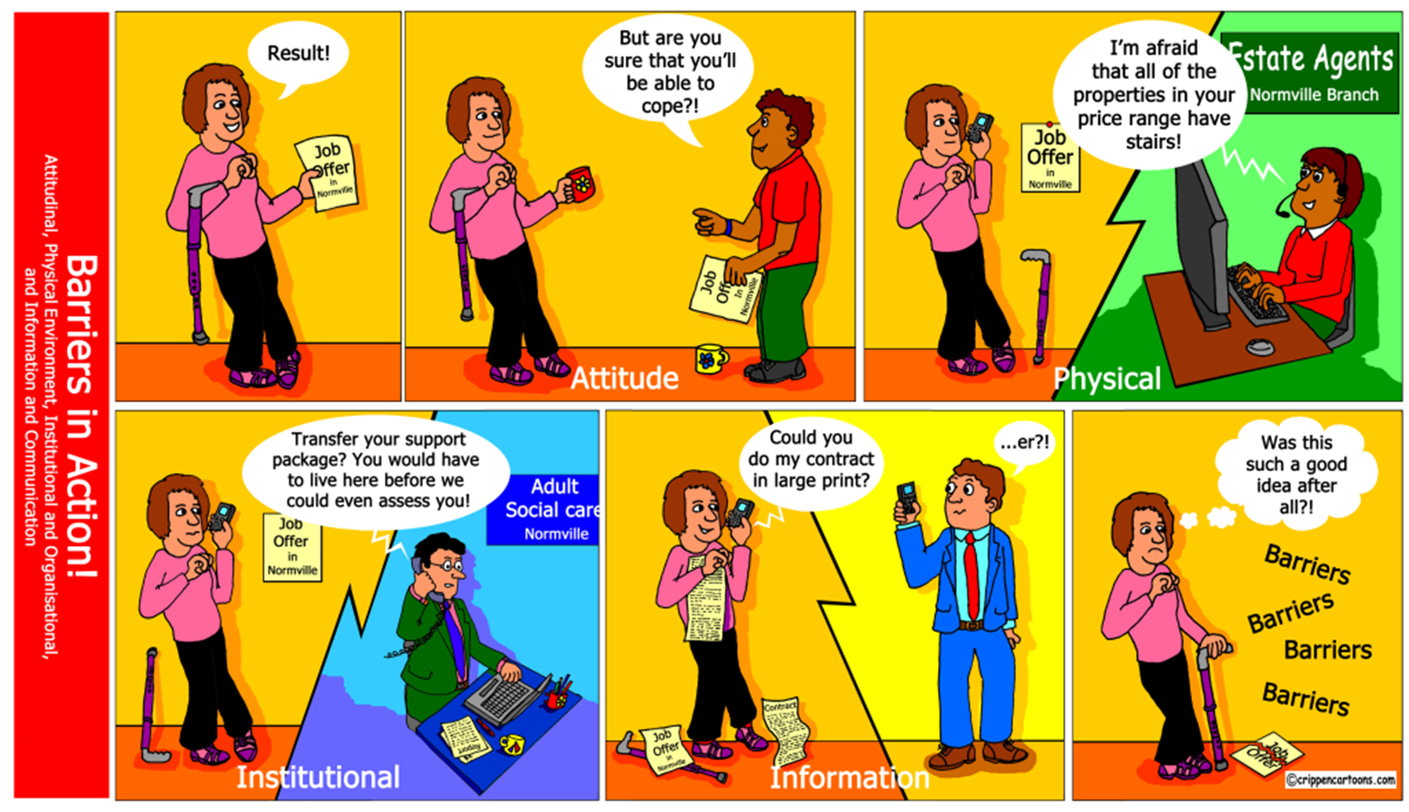
Notes:
TV

Slide 30
Example Model
Left-handedness
To help demonstrate these models, we can use left-handedness as an example.
Being left-handed is not a disability, of course, but we sometimes treat it as such.
Notes:
TV

Slide 31
Example II
Medical Model
Under this model, a child who shows left-handed tendencies might be coaxed into using her right hand and receive extra handwriting instruction or other correction.
These are individual "fixes."
Social Model
While a person's left-handedness might be a physical fact (or impairment), society turns that impairment into a disability with spiral notebooks, right-handed desks, can openers, scissors, and so on.
Providing lefty-friendly materials ensures access
Notes:
TV

Slide 32
Ableism What it is and how to address it
“Staying alive is a lot of work for a disabled person in an ableist society.” –Alice Wong, editor of Disability Visibility: First-Person Stories from the Twenty First Century
Notes:
TV

Slide 33
Ableism
Ableism refers to the ideological hypervaluation of ableness and the ways in which such norms of abled and disabled identity are given force in law, social policy, and cultural values.
Such norms shape and are shaped by claims about the impaired, non-abled body’s legitimacy or fraudulency (for instance, in claiming social benefits), legal protections, and social status.
--Fiona Kumari Campbell, "Ability," from Keywords for Disability Studies
Notes:
TV

Slide 34
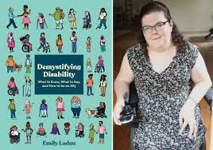
Ableism II
“Ableism is attitudes, actions, and circumstances that devalue people because they are disabled or perceived as having a disability.
To most of society, ableist beliefs and behavior don’t raise any red flags because they’re woven into the fabric of every life, simply accepted as the norm.
For disabled people, though, ableism is always there—a part of our lives that never disappears, manifesting in endless forms ranging from broad, system discrimination to individual responses. “
—Emily Ladau, Demystifying Disability: What to Know, What to Say, and How to be an Ally
Notes:
TV

Slide 35
Ableism III
It is the favoring of able neurotypical people and the exclusion and devaluation of people who are disabled and neurodivergent.
Ableism may not be intentional (in the same way that racism or sexism may not be intentional), but that doesn't mean it's not harmful.
Ellen Fraser-Barbour, "We Need to Talk about Ableism"
Notes:
TV

Slide 36
Ableism III
In two-thirds of the US there are statutes in place that allow courts to deem a parent unfit on the basis of disability, which means their parental rights are terminated.
Rideshare drivers regularly refuse rides to people who use mobility equipment or have a service animal.
Because children with Autism are largely expected to adhere to arbitrary ideas of what’s “normal”, they are often subjected to potentially harmful behavior therapy to either reinforce or quell certain behaviors.
Disabled people are frequently excluded from participating in large group meetings and events because of alack of accessibility supports such as interpreters, live captioning, and Braille, large-print or digitized materials.
The median income from Americans with disabilities is less than 70 percent of the median earnings of those without disabilities.
During the COVID-19 pandemic, many states and countries issued guidelines explicitly calling for disabilities to be taken into account as a reason to not provide life saving health care to sick people.
—Emily Ladau, Demystifying Disability: What to Know, What to Say, and How to be an Ally
Notes:
TV

Slide 37
Disability Etiquette
Overthinking is one enemy of disability etiquette, but so is making assumptions about what a person wants and needs. Of course disabled people want to be treated like everyone else, but when we say that, we don’t mean “treat every person exactly the same.” We mean “recognize our humanity and meet us where we’re at.”
--Kyle Khachadurian, cohost, The Accessible Stall podcast
Best practices
Notes:
TV

Slide 38
Etiquette
Remember that disability doesn’t define a person; it is only part of their story.
Don’t assume someone’s disability status.
Person-first language is best practice: "person who has a disability" not "disabled person."
Use bias-free language: "wheelchair user" not "wheelchair bound" or "person confined to a wheelchair." Never suggest that a person with a disability "suffers from" or "is a victim of" their condition.
Presume competence. Don’t talk down to disabled people. (infantilization-treating people as though they’re significantly below their actual age)
Notes:
TV

Slide 39
Etiquette II
Don’t be afraid to use common phrases that are part of the vernacular (e.g.: "see you soon" or "I should be running along").
Speak directly to a person with a disability, not to their aid or assistant.
Don’t try to help without asking first.
The person with the disability is your first and best resource. Do not be afraid to ask them a question about what to do, what language or terminology they prefer, and what, if any, assistance is needed.
Notes:
TV

Slide 40
Etiquette – Blind/Low Vision
Introduce yourself when you enter the room; announce when you leave the room.
Always ask before helping; do not touch a person without their permission.
Use your voice instead of nodding, pointing, or relying on facial expressions.
Notes:
TV

Slide 41
Etiquette – Blind/Low Vision II
When giving directions, be as clear and descriptive as possible. Use directional clues relative to the person when possible (e.g., "left" and "right" instead of "over there"). Avoid referring to color, shape, or other visual clues.
Be mindful of hazards such as clutter, doors partly open, furniture.
Notes:
TV

Slide 42
Etiquette – Deaf/Hard of Hearing
Gain the person's attention before starting a conversation (e.g., use a hand signal or tap them gently on the arm).
If the person uses a sign language interpreter, speak directly to the person and keep your eyes on them, not on the interpreter.
Face the person directly when speaking; avoid shouting or speaking excessively slowly.
Notes:
TV

Slide 43
Etiquette – Speech Disabilities
Be attentive and patient; wait for them to complete their communication; do not speak for the person or guess what they are trying to say.
If you don’t understand something, ask the person to repeat what they said. Rephrase what you heard and ask if it is accurate.
If the conversation is not working for one or both parties, consider asking if you can try with writing (e.g., pen/paper, electronic communication devices, etc.).
Notes:
TV

Slide 44
Etiquette – Non-Apparent/Invisible Disabilities
Not all disabilities are apparent or visible (e.g., learning disabilities, ADHD, mental health conditions, chronic health conditions, autism, and more).
If an interaction seems strained, consider some of these strategies:
Move to a quieter area
Rephrase what you said
Change the pace of the conversation
Offer to follow up via email and provide more information in written or digital format
Notes:
TV

Slide 45
Etiquette – Mobility Disabilities
Don't touch a person's mobility equipment without permission. Equipment is part of an individual’s personal space.
Always ask before assisting someone in a wheelchair. Moving a chair without permission can be dangerous to the user.
When possible, put yourself at the same eye level when talking to a wheelchair user. Sit in a chair to avoid kneeling or stooping.
Don’t assume that everyone using a wheelchair has the same limitations. People use mobility equipment for a variety of reasons, and some do not use them all the time.
Notes:
TV

Slide 46
Etiquette – Service Animals
Service animals are working. Do not touch, pet, feed, or speak to the dog. Unnecessary distractions may interfere with the dog’s ability to tend to the needs of the handler.
Don’t inquire about the nature of the handler's disability or assume the purpose of a service animal; service dogs can be trained to mitigate for a wide variety of disability needs.
Notes:
TV

Slide 47
Etiquette – Service Animals II
When walking with an individual and their service animal, walk on the side opposite the service animal. As you are walking, describe the setting, noting any obstacles or hazards along the way.
If you see a service dog off-leash or not under the control of the handler, bring your concerns to an Administrator.
Notes:
TV

Slide 48
What to Say
Say This ☺
disability/disabled
person with a disability/disabled person
has a disability
is disabled
Not This ☹
differently abled
handi-capable
handicap/handicapped
special needs
afflicted by
suffers from
victim of
Adapted from Emily Ladau, Demystifying Disability: What to Know, What to Say, and How to be an Ally

Slide 49
What to Say II
Say This ☺
person who is able
person who is unable to
person with high support needs
Not This ☹
high functioning
low functioning
Adapted from Emily Ladau, Demystifying Disability: What to Know, What to Say, and How to be an Ally

Slide 50
What to Say III
Say This ☺
neurodivergent
person with Autism/Autistic person
person with a cognitive disability/cognitively disabled person
person with an intellectual disability/intellectually disabled person
person with a learning disability/learning disabled person
Not This ☹
mentally challenged
mentally handicapped
mentally retarded
slow
special ed
Adapted from Emily Ladau, Demystifying Disability: What to Know, What to Say, and How to be an Ally
Notes:
These types of disabilities are not all the same but they are often grouped together

Slide 51
What to Say IV
Say This ☺
abled-bodied (if not physically disabled)
does not have a disability
neurotypical (if not neurodivergent
nondisabled
Not This ☹
normal
regular
Adapted from Emily Ladau, Demystifying Disability: What to Know, What to Say, and How to be an Ally

Slide 52
What to Say V
Say This ☺
person who uses a wheelchair
wheelchair user
little person
person of short stature
person with dwarfism/dwarf
Not This ☹
wheelchair-bound
confined to a wheelchair
midget
Adapted from Emily Ladau, Demystifying Disability: What to Know, What to Say, and How to be an Ally

Slide 53
What to Say VI
Say This ☺
Person with a mental health disability
Person with mental illness/mentally ill person
Person with a psychiatric disability/psychiatrically disabled person
Not This ☹
crazy
disturbed
insane
lunatic
mad
psychotic
Adapted from Emily Ladau, Demystifying Disability: What to Know, What to Say, and How to be an Ally

Slide 54
What to Say VII
Say This ☺
person with a physical disability/physically disabled person
Not This ☹
cripple
gimp
invalid
spaz
Adapted from Emily Ladau, Demystifying Disability: What to Know, What to Say, and How to be an Ally

Slide 55
What to Say VIII
Say This ☺
accessible parking/restroom
Not This ☹
disabled restroom
handicapped parking
Adapted from Emily Ladau, Demystifying Disability: What to Know, What to Say, and How to be an Ally

Slide 56
Calling In, Calling Out
Public call outs in the moment often aren’t as effective or not possible. Calling out assumes the worst.
Following up privately (calling a person in) is often more effective. It invites the person into a conversation.
I’m sure you didn’t have any bad intentions here, but I just wanted to let you know that [word, phrase, action] was actually pretty discriminatory toward [disabled people, people of color, women], and that’s not okay. If you meant [nondiscriminatory alternative], why not just say that next time?

Slide 57
Wrapping Up
“I challenge you to take all your stereotypical preconceived notations about what disability does or doesn’t look like and throw them out the window. Skip the assumptions and instead focus on incorporating disability etiquette, and prioritizing accessibility into all your interactions.”
—Emily Ladau, Demystifying Disability: What to Know, What to Say, and How to be an Ally

Slide 58
Resources
Report an Accessibility Issue Form – links are also found at OARS.uncg.edu and Accessibility.uncg.edu
Questions about ensuring online courses are accessible - accessibility@uncg.edu
Questions about other accommodations - oars@uncg.edu
Referrals: Starfish, chat box at oars.uncg.edu, Welcome Form for students (see handout)
Section 504 of the Rehabilitation Act of 1973
Section 508 of the Rehabilitation Act of 1973
ADA Title II and III Fact Sheets

Slide 59
Resources II
Campus Accessibility Information – many resources, including how-to instructions/demos
Learning Disabilities Handout
Introduction to Universal Design - Section508.gov offers an overview of Universal Design
ADA - Service Animals
UNCG Policy - Animals on Campus

Slide 60
Legal Cases
NCA&T OCR Complaint 11-20-2024 Case Resolution and OCR Letter to NCA&T (timely provision and do not negotiate with student)
U.S. v. Morvant (personal liability for failure to accommodate individual with disability); see also Howe v. Hull
Sjostrand v. The Ohio State University, No. 13-3449 (6th Cir. April 2014) – (rejected program application due to disability)
Settlement Agreement between USA and Louisiana Tech University, DJ #204-33-116 (June 2013) – (inaccessible internet-based application)
Kennesaw State University, No. 04-16-2114 (OCR 2017) – (physical inaccessibility and inadequate grievance procedures)

Slide 61
Legal Cases II
Arapahoe Community College, No. 08-11-2052 (OCR 2012) (need to address F/A appeal relevant to disability)
Schneider v. Shah, No. 12-2055 (3rd Cir. 2012) (need for prompt engagement of interactive process)
Globe University, No. 05-10-2165 (OCR 2011) (communication with university officials indicated need for potential accommodations even though student did not notify DS office – essentially, university was “on notice” that a student had a disability)
Antelope Valley College, No. 09-11-2281 (OCR 2012) (need to follow accommodations; need for adequate and timely grievance procedures)
United States vs. University of Nebraska Kearney (Sept. 2015) – (UNK fined $140,000 for failure to allow ESA); see also United States vs. Kent State University (Jan. 2016)
Notes:
Arapahoe CC – AHEAD access - http://ahead.wiley.com:8080/ahead/articles/view/6193
Schneider v. Shah – AHEAD - http://ahead.wiley.com:8080/ahead/articles/view/6034
Globe – AHEAD - http://ahead.wiley.com:8080/ahead/articles/view/6199
Antelope Valley – AHEAD - http://ahead.wiley.com:8080/ahead/articles/view/6190

Slide 62
Legal Cases III
University of Utah, No. 08092024 (OCR 6/24/2009) – (failure to provide notice of designated Section 504/Title II coordinator)
Kennesaw State University, No. 04-12-2275 (OCR 1/29/2013) – (Faculty must provide accommodations on a timely basis)
North Carolina State University, No. 11-10-2054 (OCR 09/09/2010) – (appropriate alternative if an accommodation is not available – e.g., note taker is absent, etc.)
City University of New York Queensborough Community College, No. 02-12-2058 (OCR 2012) (tape recorder not permitted in class; it was requested but DS office didn’t list it on accommodation notice)
Notes:
University of Utah – AHEAD - http://ahead.wiley.com:8080/ahead/articles/view/5769
Kennesaw State – AHEAD - http://ahead.wiley.com:8080/ahead/articles/view/6183
NCSU – AHEAD - http://ahead.wiley.com:8080/ahead/articles/view/5925
CUNY Queensborough – AHEAD - http://ahead.wiley.com:8080/ahead/articles/view/6177

Slide 63
Questions

